Slide 1
Town Life
London

Slide 2
Objectives
Name the objects in the streets
Ask the way
Show the way
Speak about London and its sights
Notes:
Ask about the objectives of the topic

Slide 3
Town Life
In the street
Notes:
The topic of the next few lessons

Slide 4
New Vocabulary
city
town
one of the biggest cities
the city of London
a small town
in town
(in the country)
out of town
leave town
go to town
Notes:
See the difference
Я живу в городе, а моя бабушка – в деревне.
Мои родители переехали в город много лет назад.
Мы проводим выходные за городом.
Ее нет в городе.
Летом все хотят уехать из города.

Slide 5
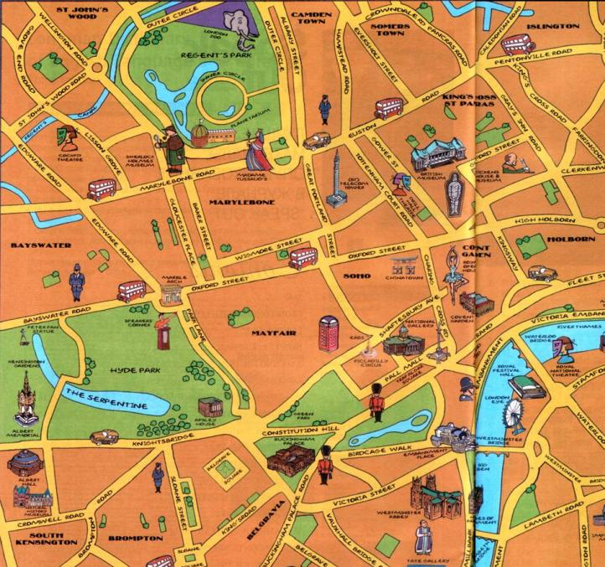
New Vocabulary
Notes:
What can you see on the city map?

Slide 6
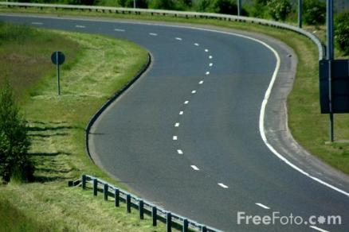
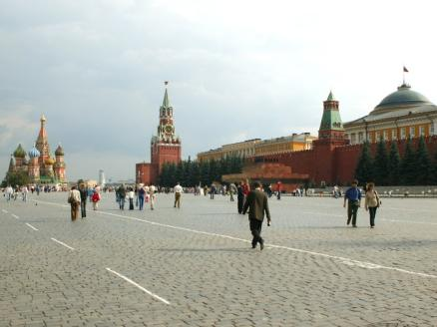
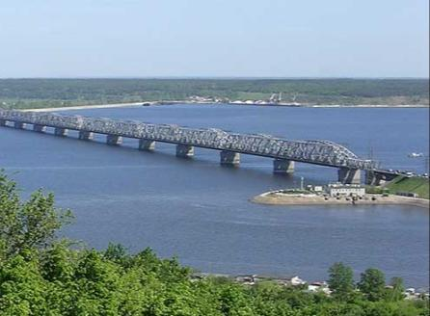
New Vocabulary
bridge
road
square

Slide 7
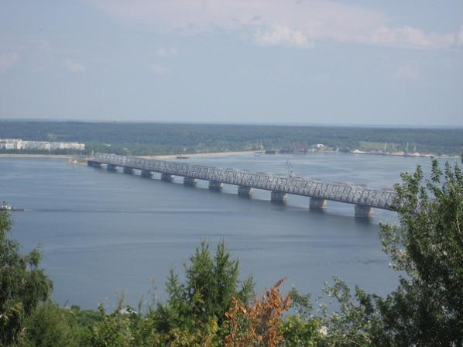
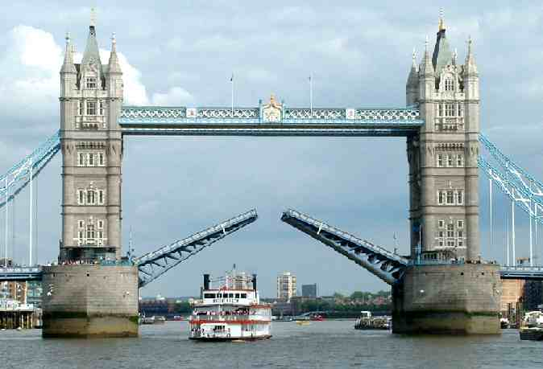
Tower Bridge
Notes:
How many bridges are there in Ulyanovsk? (over the Volga)
What other famous bridges do you know?

Slide 8
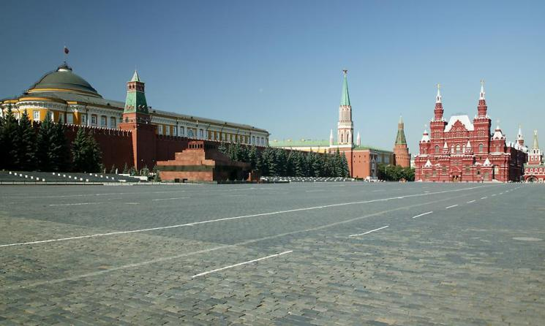
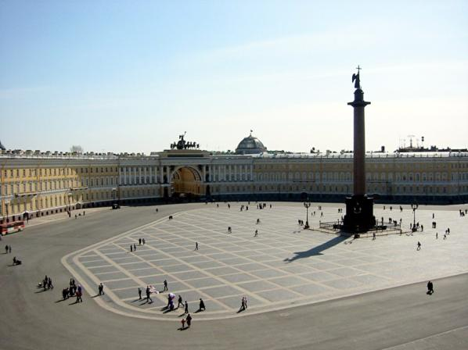
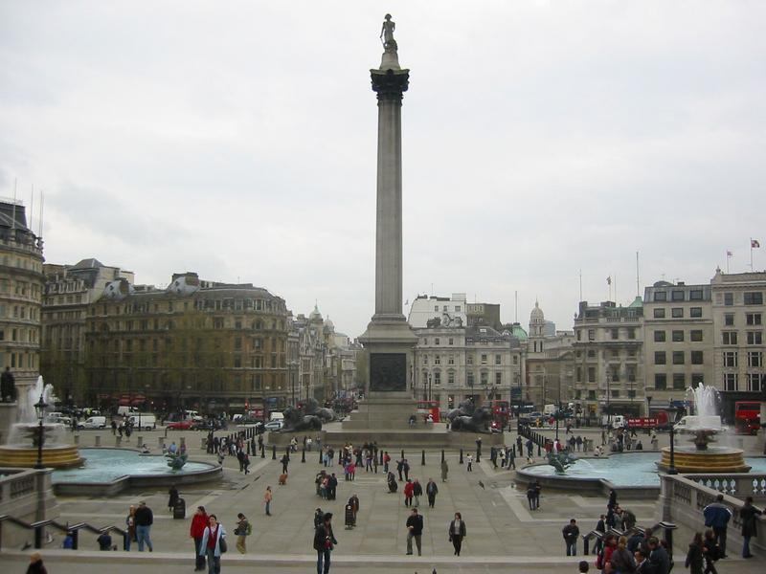
Trafalgar Square
Notes:
What are their names?
Where are they situated?

Slide 9
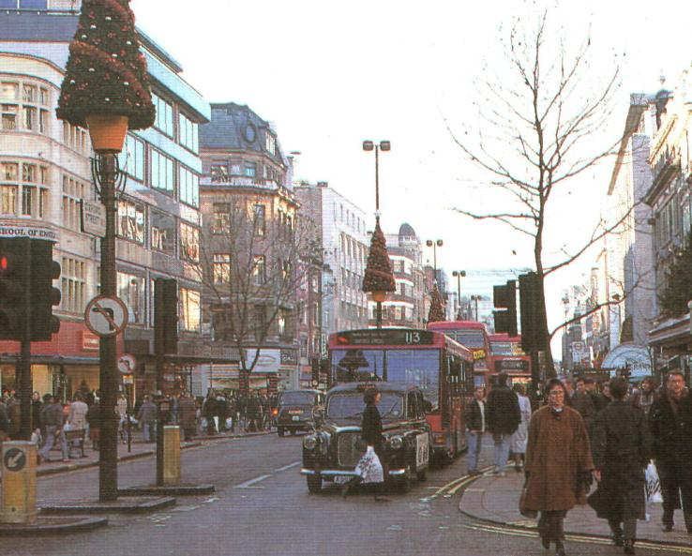
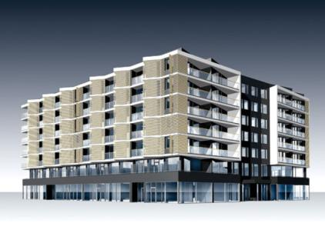
New Vocabulary
building
main street
Notes:
Goncharov street is the main street of our city.
What other main streets do you know?
What is the main square in your city? In Moscow? In St Petersburg?
What can you see in the street?
buildings

Slide 10
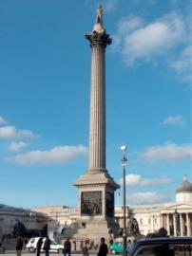
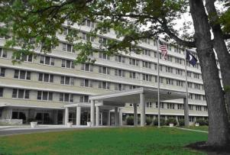
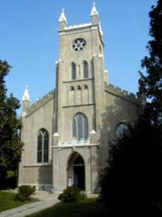
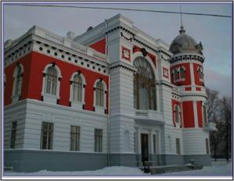
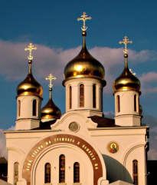
New Vocabulary
museum
cinema
hospital
theatre
hotel
church
monument
supermarket
Notes:
Do people go to church now?
When do people often go to church?

Slide 11
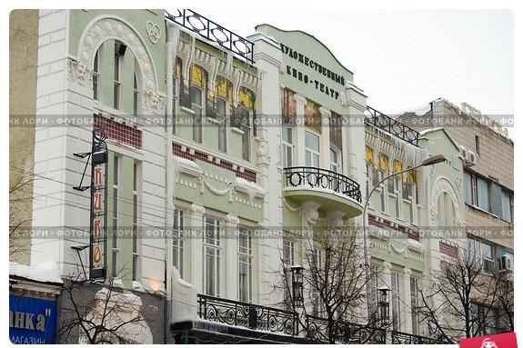
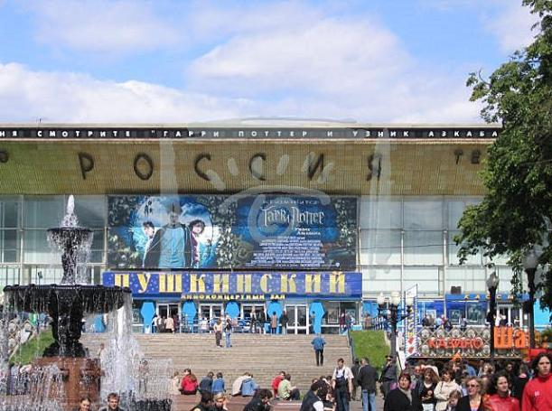
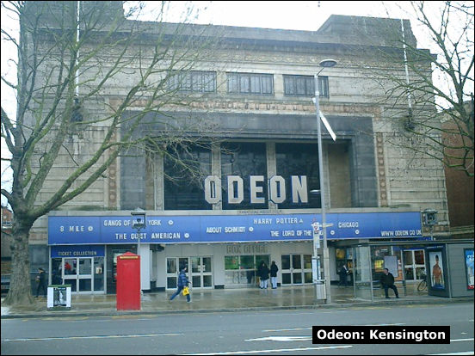
What is on at the … ?
Notes:
How often do you go to the …
With whom do you go to the …

Slide 12
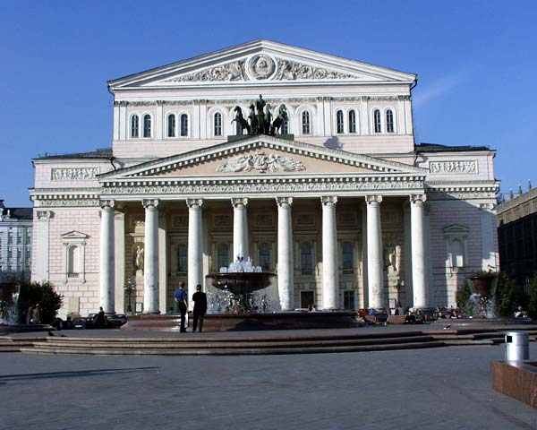
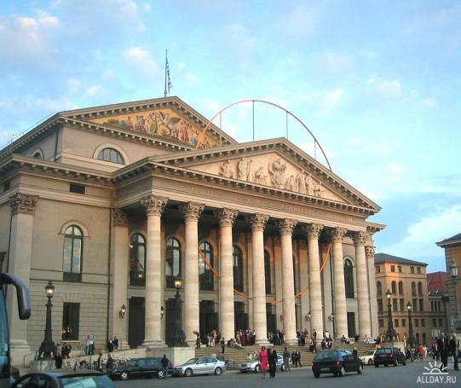
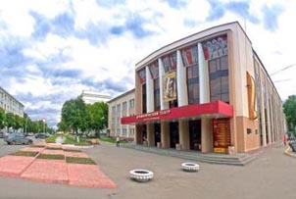
What is on at the … ?
Notes:
How often do you go to the …
With whom do you go to the …

Slide 13
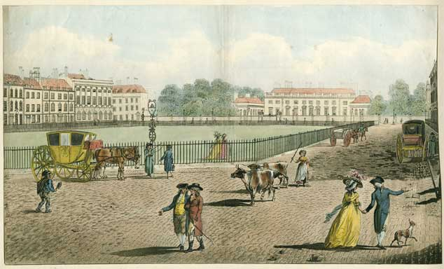
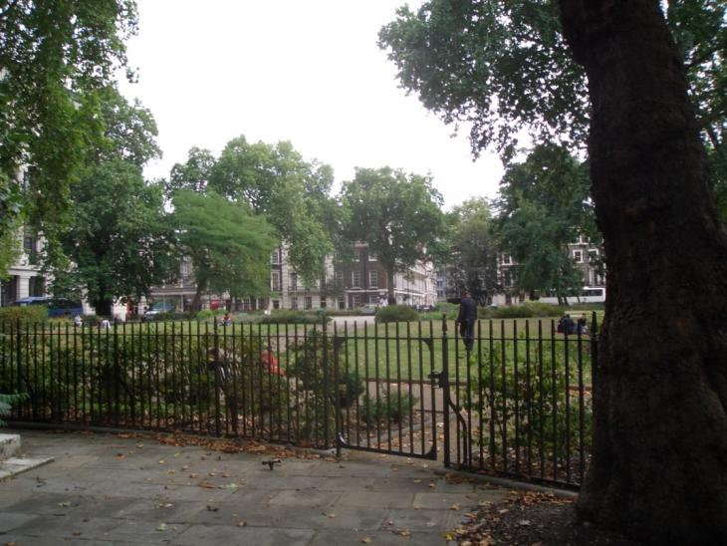
Bloomsbury Square

Slide 14
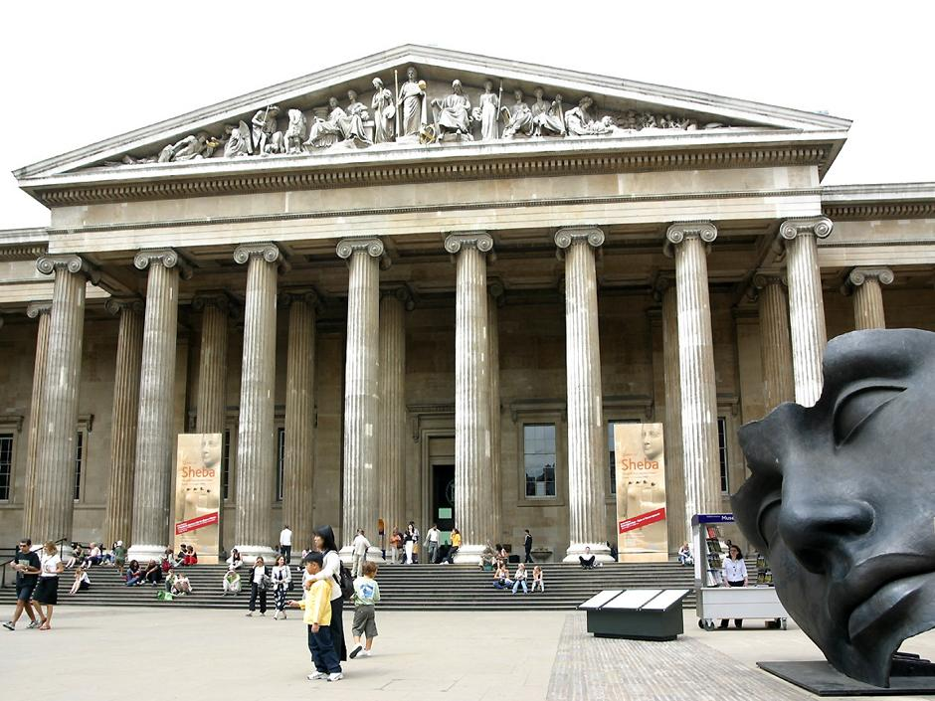
The British Museum

Slide 15
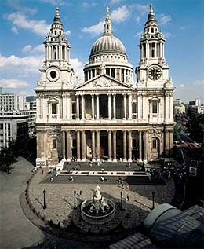
St. Paul’s Cathedral

Slide 16
Royal Opera House

