Slide 1
English homes

Slide 2
at …
on the right…
on the left…
in front of…
behind…
far from…

Slide 3
at …
on the right…
on the left…
in front of…
behind…
far from…

Slide 4
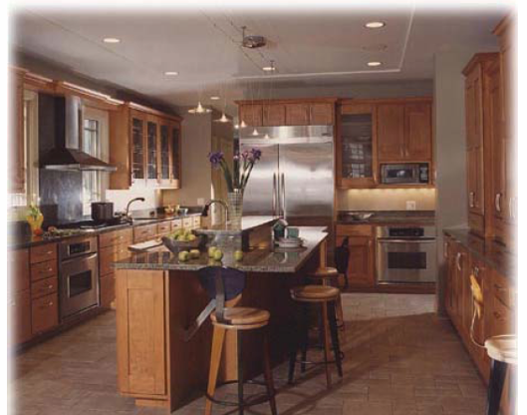
Kitchen

Slide 5
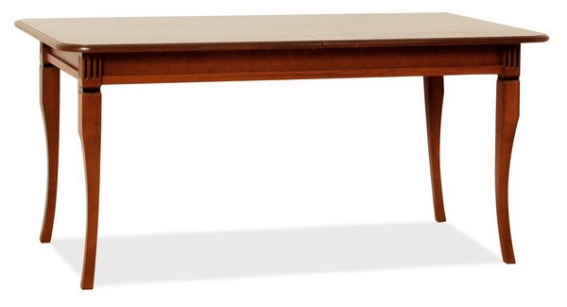
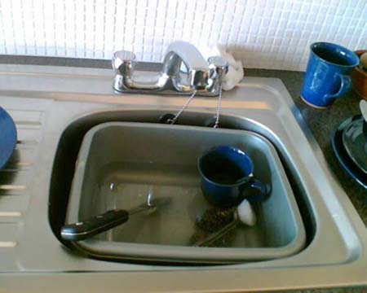
What is there in the kitchen?

Slide 6
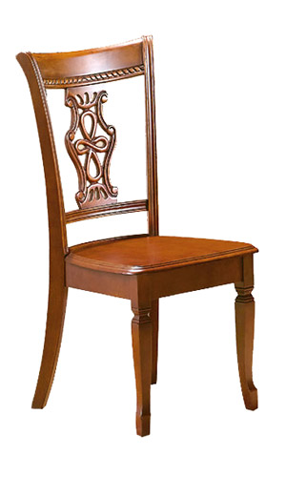
What is there in the kitchen?

Slide 7
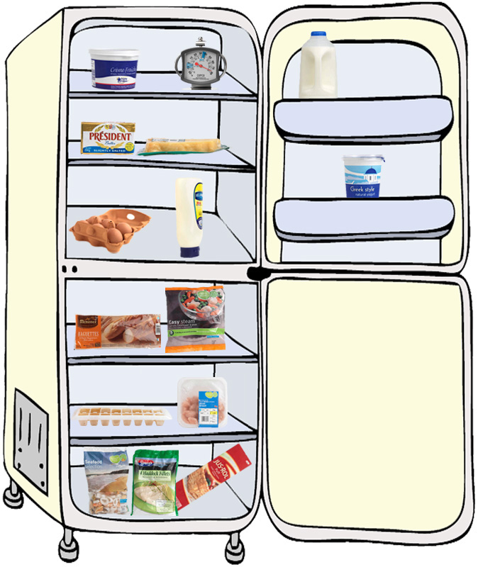
What is there in the kitchen?
fridge

Slide 8
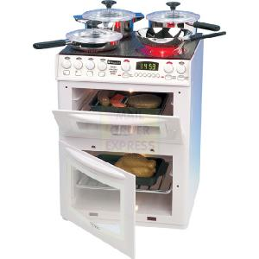
What is there in the kitchen?
cooker

Slide 9
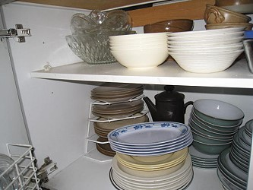
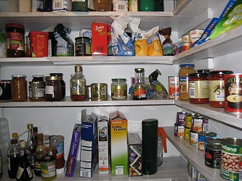
What is there in the kitchen?
cupboard

Slide 10
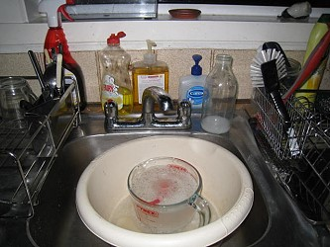
What is there in the kitchen?
sink

Slide 11
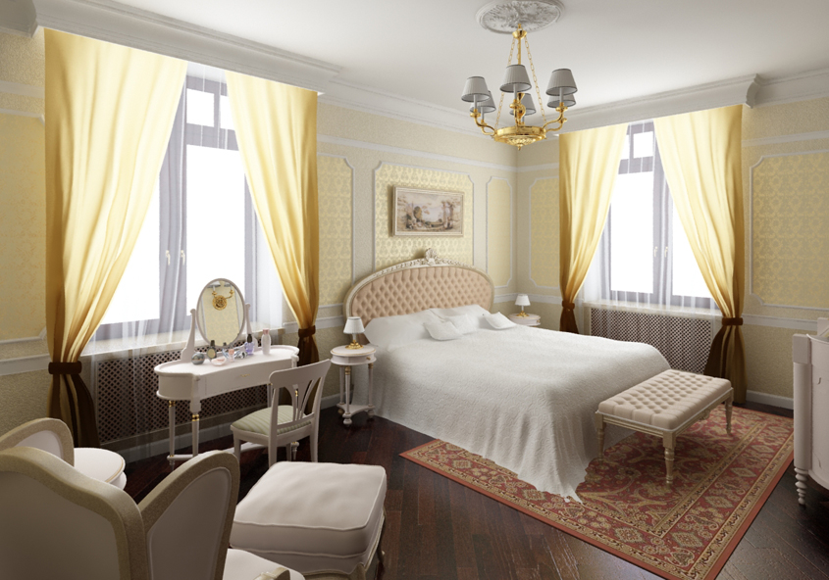
Bedroom

Slide 12
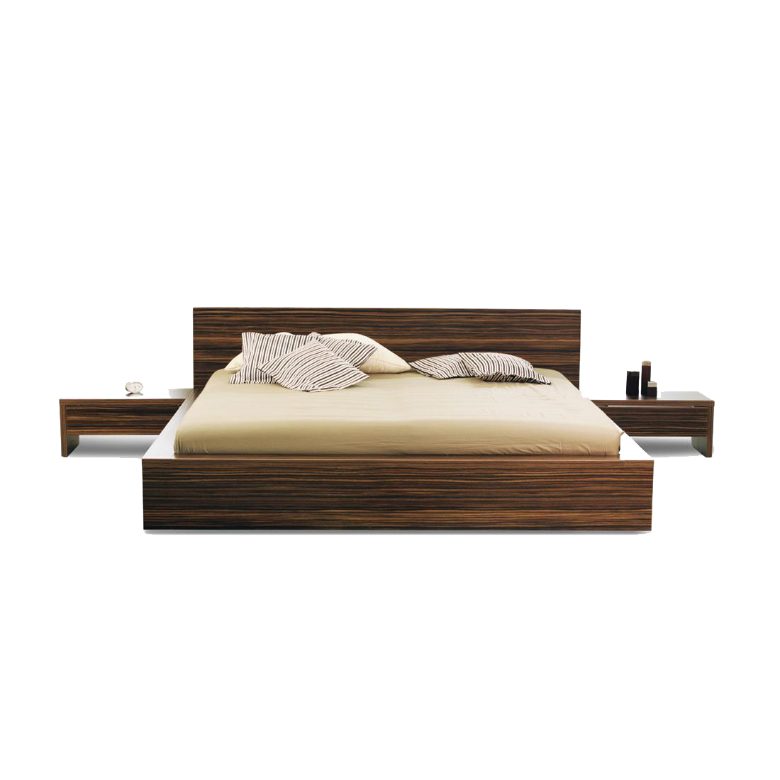
What is there in the bedroom?

Slide 13
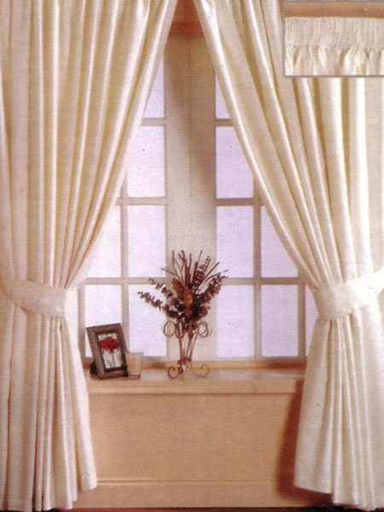
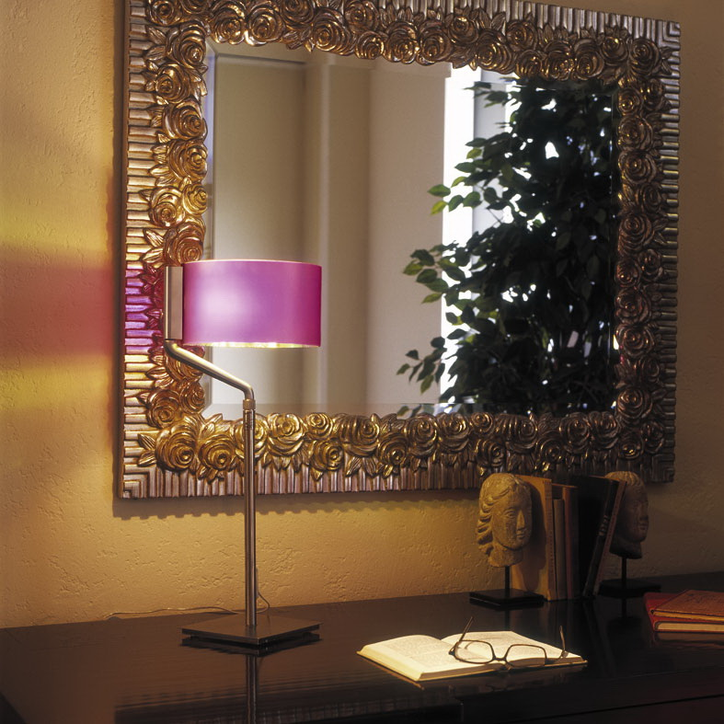
What is there in the bedroom?

Slide 14
What is there in the bedroom?
bedside table

Slide 15
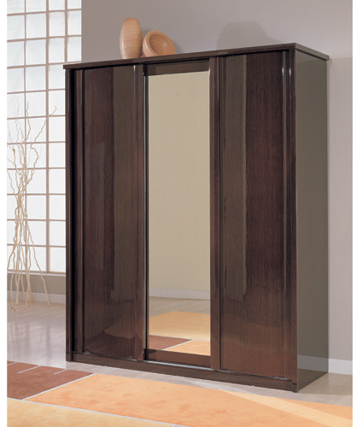
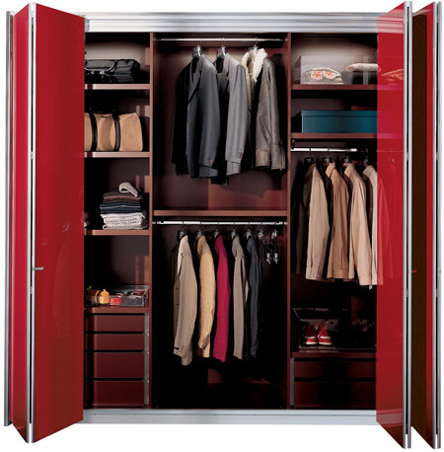
What is there in the bedroom?
wardrobe

Slide 16
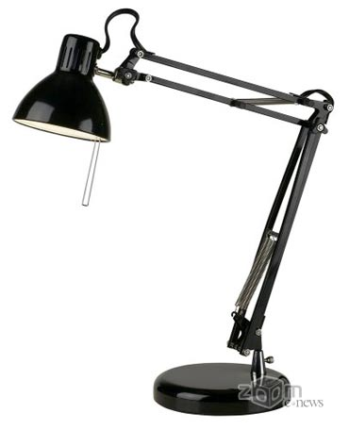
What is there in the bedroom?
lamp

