Slide 1
What do you want to be?
Lesson 14

Slide 2

He is a doctor
He is a doctor
He is a doctor.

Slide 3

She is a doctor
She is a doctor
She is a doctor.

Slide 4
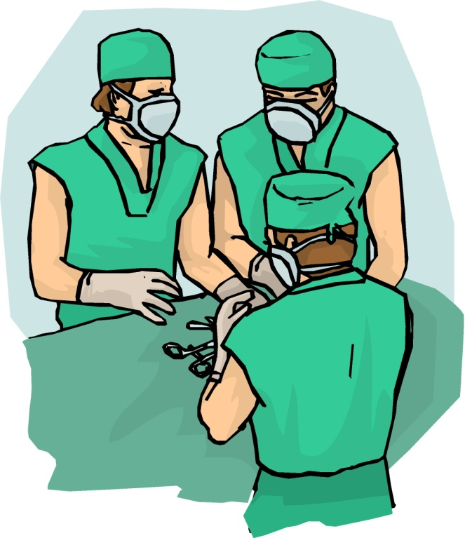
They ara doctor
They are doctors
They are doctors.

Slide 5
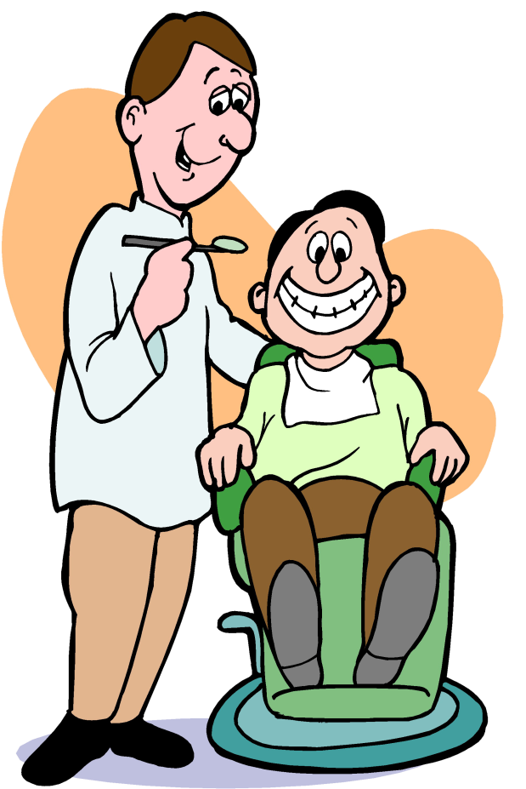
He is a dentist
He is a dentist
He is a dentist.

Slide 6

They ara dentist
They are dentists
They are dentists.

Slide 7

He is an engineer
He is an engineer
He is an engineer.

Slide 8


They an engineer
They are engineers
They are engineers.

Slide 9
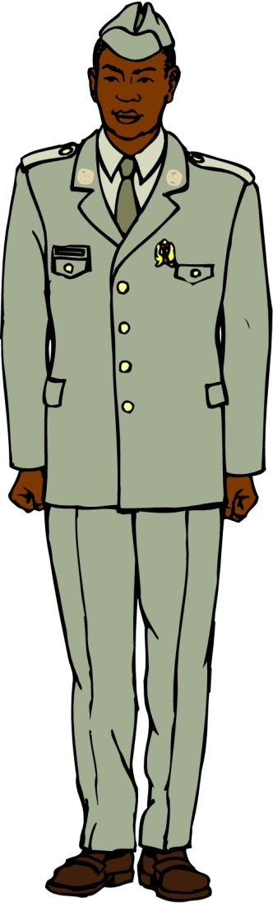
He is an officer
He is an officer
He is an officer.

Slide 10
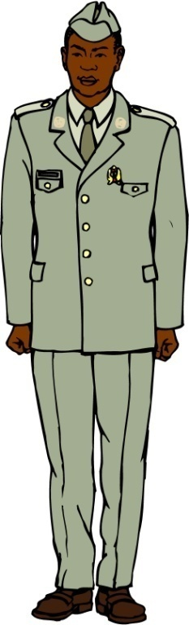
They an officer
They are officers
They are officers.

Slide 11
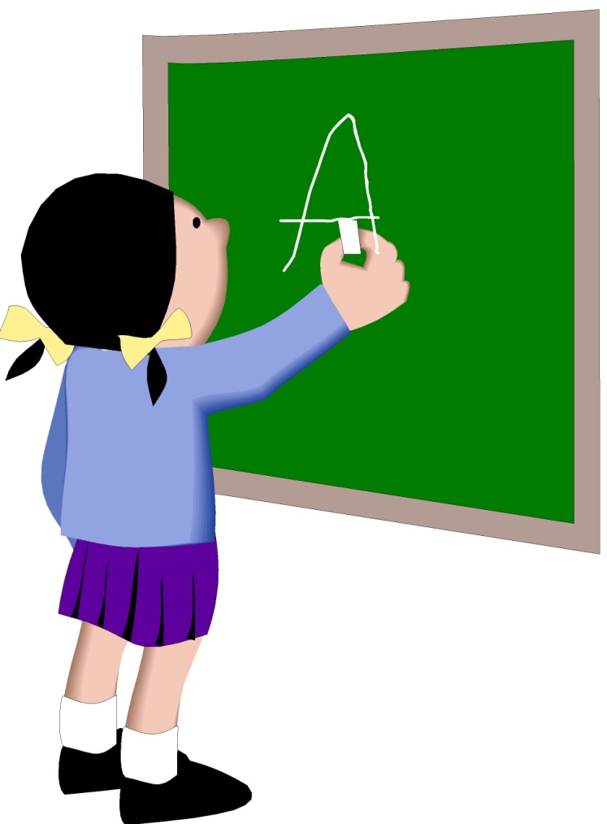
She is a pupil
She is a pupil
She is a pupil.

Slide 12





What is he/she?

Slide 13

What are they?

Slide 14
is (not)
My mother
My father
My sister
My brother
My grandmother
My grandfather
My aunt
My uncle
a doctor
a dentist
an engineer
an officer
a pupil

Slide 15

What do you want to be?
I want to be a (an) … .
He/She wants to be a (an) … .

Slide 16

What do you want to be?
I want to be a (an) … .
He/She wants to be a (an) … .

Slide 17

What do you want to be?
I want to be a (an) … .
He/She wants to be a (an) … .

Slide 18
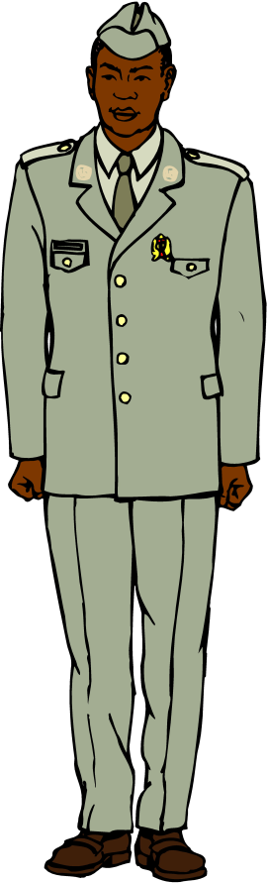
What do you want to be?
I want to be a (an) … .
He/She wants to be a (an) … .

Slide 19
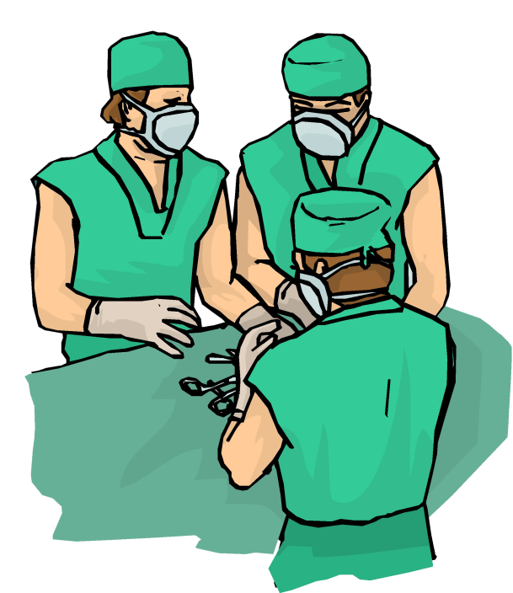
What do you want to be?
We want to be …s .
They want to be …s .

Slide 20
a doctor
a dentist
an engineer
an officer
a pupil
I want to be
He/she wants to be

